Slide 1

ADSAI: Data Science 1: The World in Data
Bram Heijligers

Slide 2

Who am I?
Bram Heijligers
BSA International Game Architecture and Design – Design and Production, 2012 - 2018; BUas
Game Designer at &ranj. 2017 - 2018
MSc Cognitive Science and Artificial Intelligence, 2018 - 2020; Tilburg University (TiU) + working at MindLabs
Managing Covid-19 contract tracing operations; using DS, at the GGD, 2020 - 2021
Lecturer DS & PhD-candidate [Neuro-cognitive research into (team) games], 2021 - Ungoing; TiU
Making things in general
Cooking & baking bread
Drinking, eating, socializing
Walking & hiking
Reading & writing
Playing, developing & researching games
Running, fitness, meditation

Slide 3
What is data science?
Bram:
“Somebody who solves problems using data analyses in a computerized environment.”
Wikipedia:
“Data science is an interdisciplinary field that uses scientific methods, processes, algorithms and systems to extract knowledge and insights from noisy, structured and unstructured data, and apply knowledge and actionable insights from data across a broad range of application domains.”
IBM:
“Data science combines the scientific method, math and statistics, specialized programming, advanced analytics, AI, and even storytelling to uncover and explain the business insights buried in data.”

Slide 4

What is data science?
Drew Conways's Data Science venn diagram

Slide 5
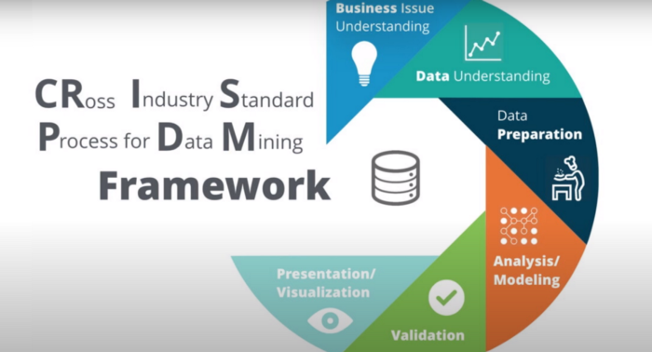
CRISP-DM

Slide 6
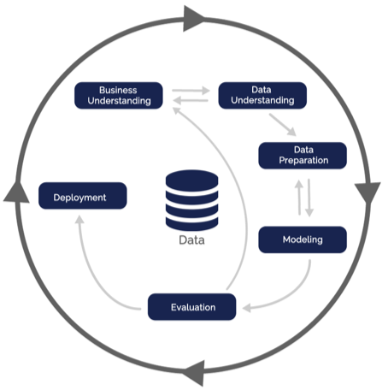
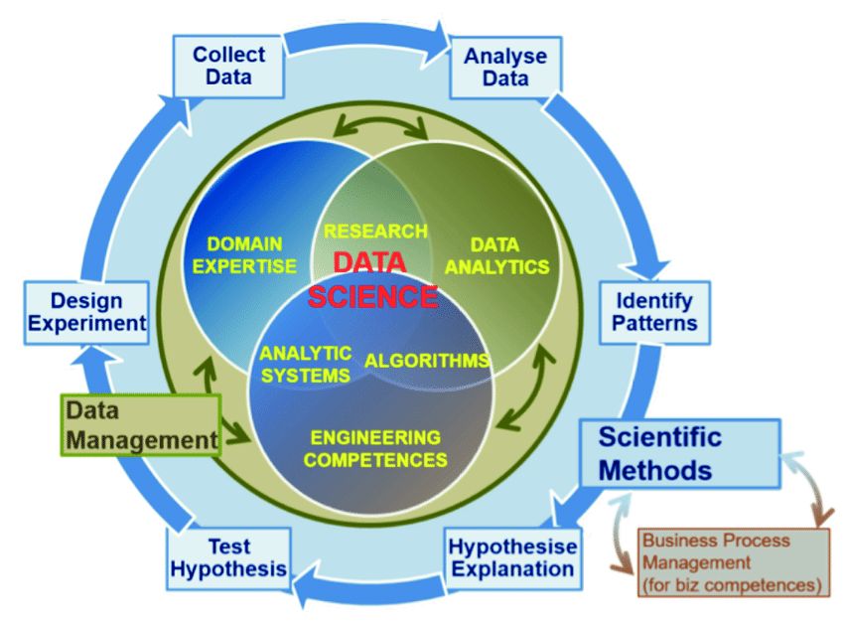
CRISP-DM
There are many varieties...
We base our curriculum on the EDSION Data Science Competency Framework;
as proposed by the European Union.
This will set the rhythms of your blocks and projects.
Block A: High-level perspective on entire cycle
So we’ll do all this using data!

Slide 7
But what is data?!
Bram:
“Real-world (abstract) properties translated into some discrete form; numbers or text, so people can understand (or relationships between) objects and/or phenomena”
Wikipedia:
“Data are individual facts, statistics, or items of information, often numeric, that are collected through observation. In a more technical sense, data are a set of values of qualitative or quantitative variables about one or more persons or objects, while a datum (singular of data) is a single value of a single variable.”
Cambridge Dictionary:
“information, especially facts or numbers, collected to be examined and considered and used to help decision-making, or information in an electronic form that can be stored and used by a computer:”

Slide 8
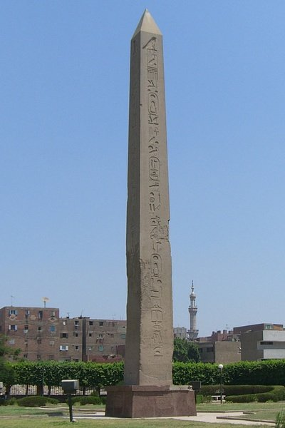
How do we describe an object?
Words are commonly used to describe an object, it’s relationship and it’s place in the world.
Here we see an obelisk
Large
Long
Old
Heavy
[Student examples]
These words we assign to an object can be further defined in a more precise way.
Specifically we can use numbers or categories to give them a more meaningful description.
We call these ‘descriptions’ variables and they’ve been around since the dawn of language:
Pre-historic: Dog-Dog-Dog
Now: Three dogs

Slide 9
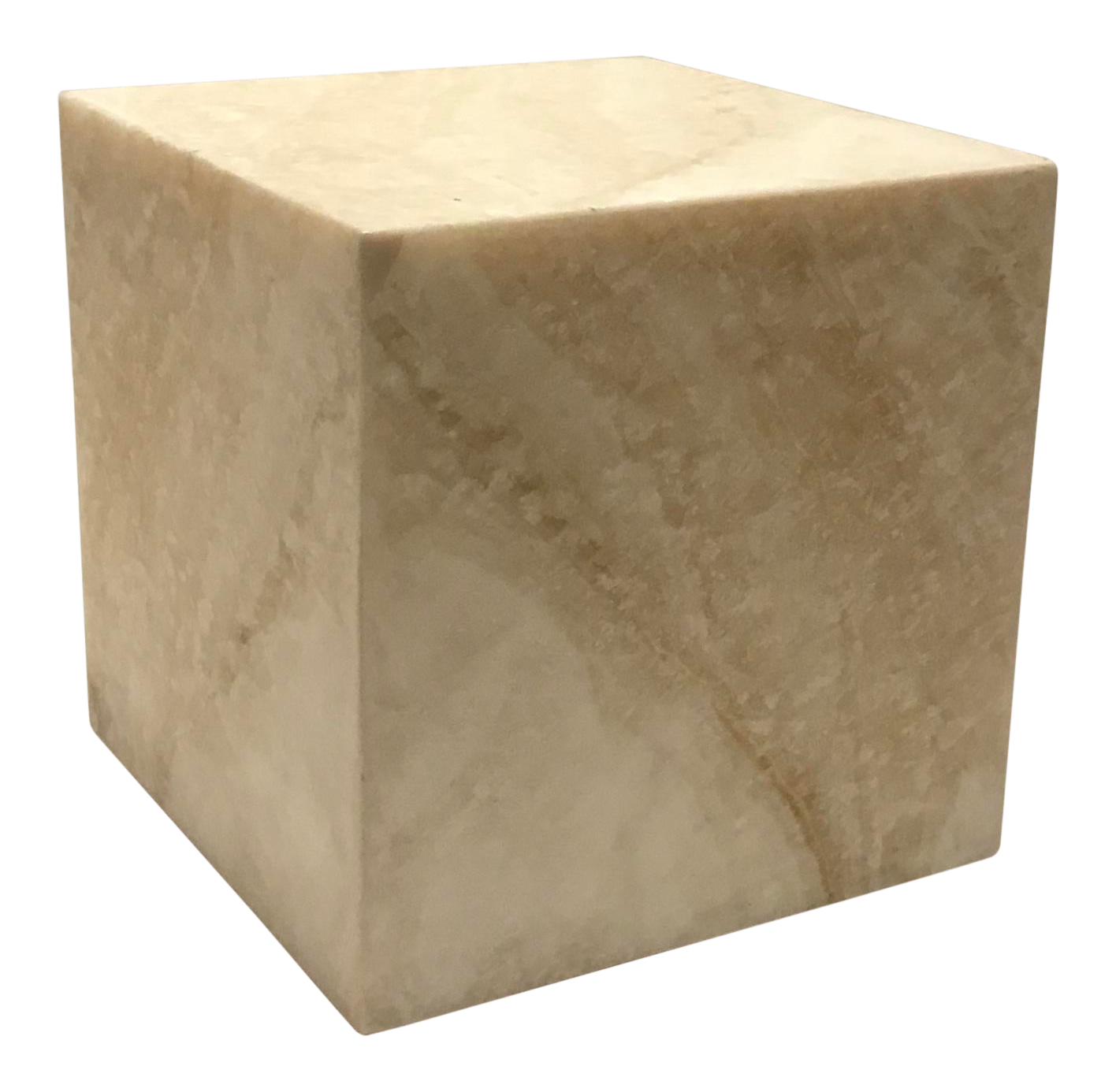
Objects quantified to data
Variables:
Shape = Cube
Size = 1 x 1 x 1 Meters = 1 m ³
Material = Marble
Material Density = 0.5 g/cm ³
Weight = Size X Material Density
Weight = 0.5 g/cm ³ X 1.000.000
Weight = 500.000 grams = 500 KG
Notes:
Mass
Weight
Height
Age
Orientation
Position

Slide 10
Why would do we do this?
To solve problems.
But how does this help us?
Mathematics is essential an abstract way to define relationships between real-world entities.
Translating real-world properties into data enables us to leverage that toolbox: it gives us a framework with which we can understand objects and phenomena in the world and how they affect one another.
.

Slide 11
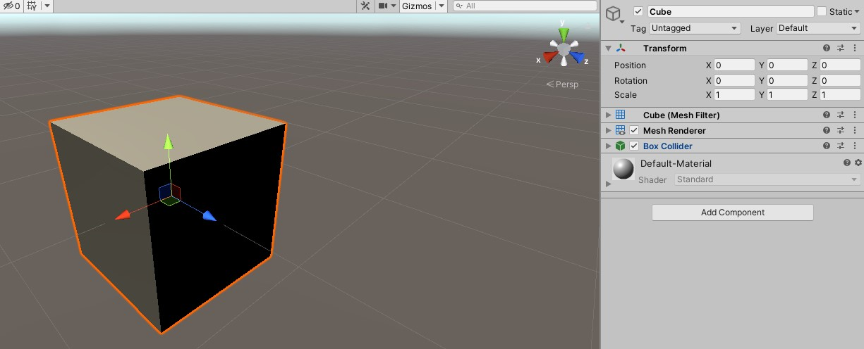
Objects quantified to data
Variables:
[var1]
Notes:
Mass
Weight
Height
Age
Orientation
Position

Slide 12
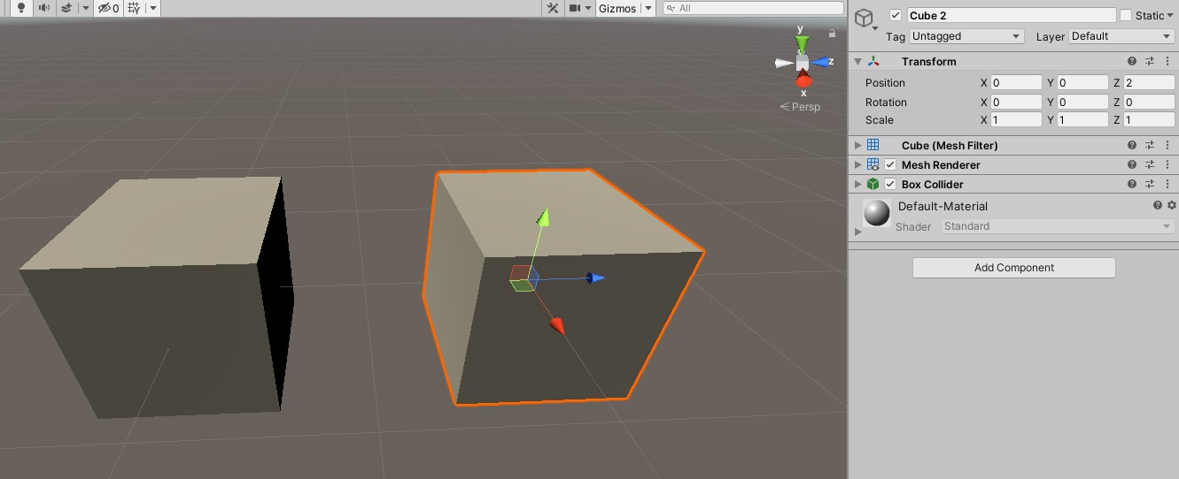
Objects quantified to data
Variables:
[var1]
Notes:
Mass
Weight
Height
Age
Orientation
Position

Slide 13
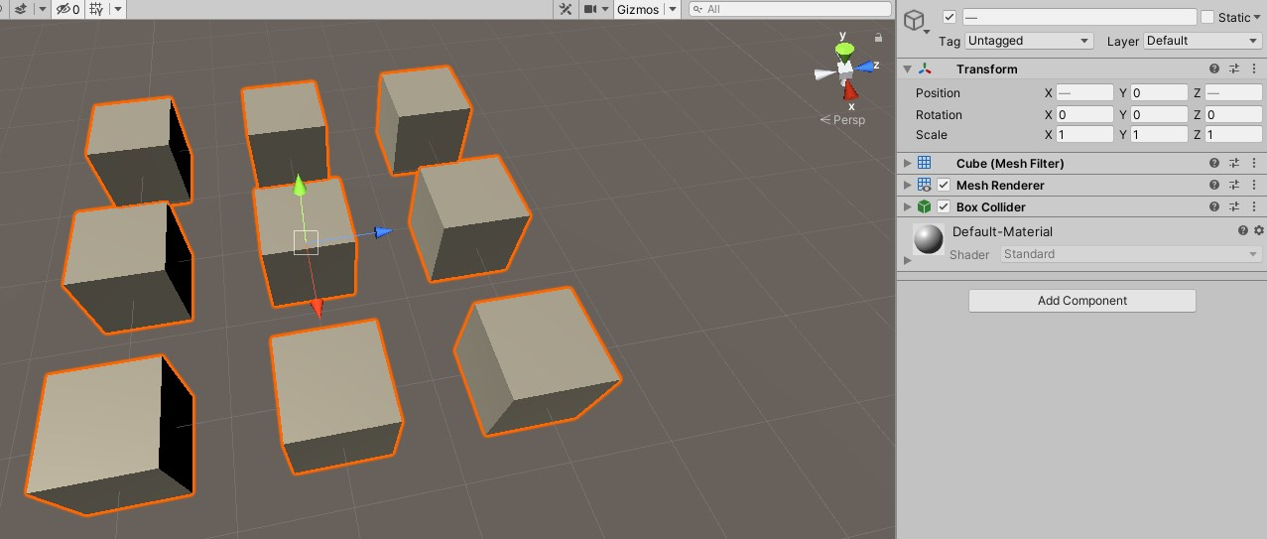
Objects quantified to data
Variables:
[var1]
Notes:
Mass
Weight
Height
Age
Orientation
Position

Slide 14

You in data?
Age
Height
Weight
Location (X,Y,Z) at Time A
[Student examples]

Slide 15
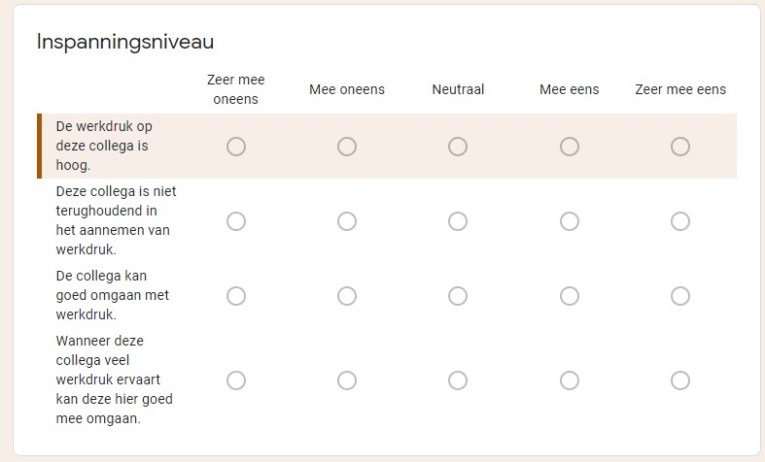
Bram in data
You can also capture social and behavioural phenomena about an individual, group, organisation or society using data science.
A well known example of these are questionnaires.
A snapshot of a questionnaire
I took among my colleagues at
the GGD to reliably represent
my competencies for my job
application as a lecturer.

Slide 16
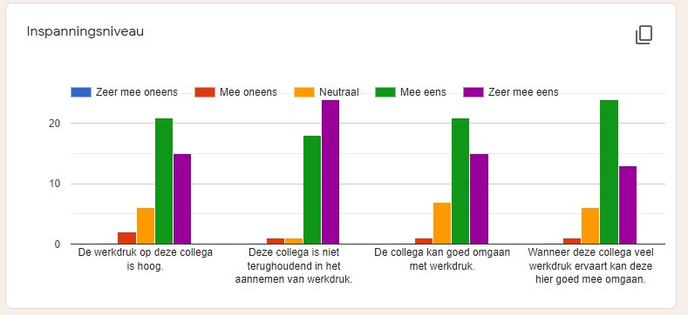
Bram in data
Once you collected the data; provided the questionnaire is robust, you can see a phenomena in action. In this case, how my colleagues perceived my ability to handle a large workload and the accompanying pressure:
In week 7 we’ll use one to gather and process feedback ourselves. Exciting sstuff!

Slide 17
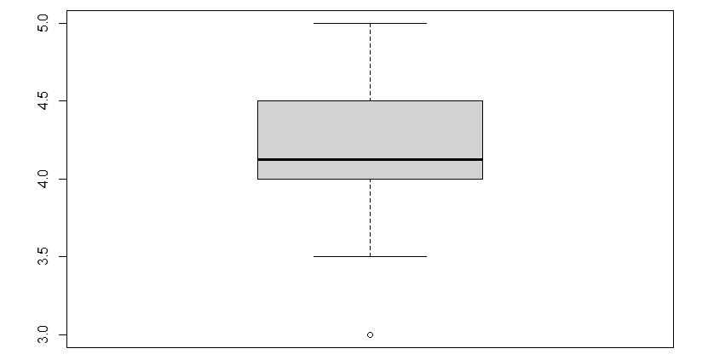
Bram in data
The next step is creating a so called aggregate variable. An aggregate variable condenses the 4 responses into a single score per person. The distribution of the score is displayed below here (Mean = 4.214, Median = 4.125, N = 44).
It’s a fun demonstration but doing data gathering and statistical analysis like this is outside of the scope of this block. We’ll look at this again in year 2!

Slide 18
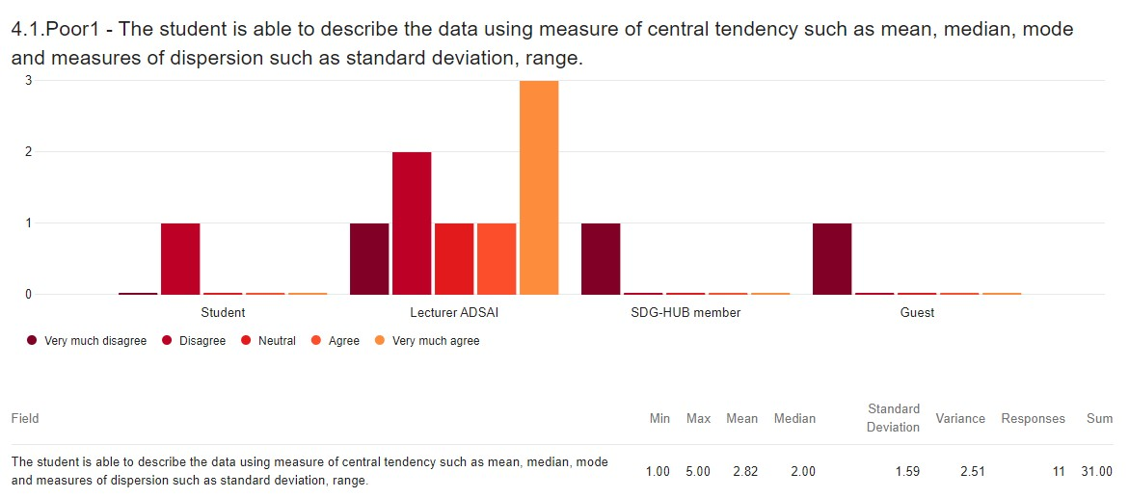
We’ll gather and process feedback ourselves too!

Slide 19
Cool, but what about non-objects?
Everything we don’t classify as an object is essentially a phenomenon.
It’s essentially something objects do which can be observed somehow: like a verb.
Cambridge dictionary:
Something that exists and can be seen, felt, tasted, etc., especially something unusual or interesting

Slide 20

How do we describe phenomena?
People interacting?
Teamwork?
Particles interacting?
Some sort of unexpected effect?
Glaciers melting?
Social change: e.g. forms of inequality?

Slide 21

How do we describe phenomena?
Like the weather?
Humidity
Luminosity
Cloud height
Electrical Load
Voltage
Ampere
Ohm
Watt
Dynamic properties...
[Student examples]
On a small scale weather is difficult to predict...

Slide 22
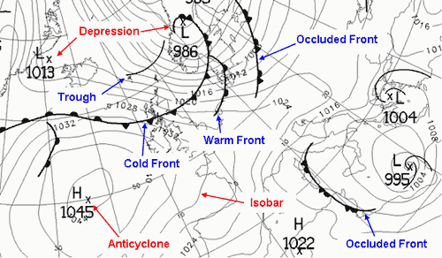
Phenomena quantified
But on a large scale, weather can become predictable: that’s why we have weather forecasts.
You can predict many phenomena and their future states or outcomes.
But, a model is always reductionistic: a simplified version of reality!
Something which has recently been kind of a thing is the spread of Covid-19, you may have heard of it.
https://gisanddata.maps.arcgis.com/apps/opsdashboard/index.html#/bda7594740fd40299423467b48e9ecf6
https://www.cdc.gov/coronavirus/2019-ncov/covid-data/forecasting-us.html

Slide 23
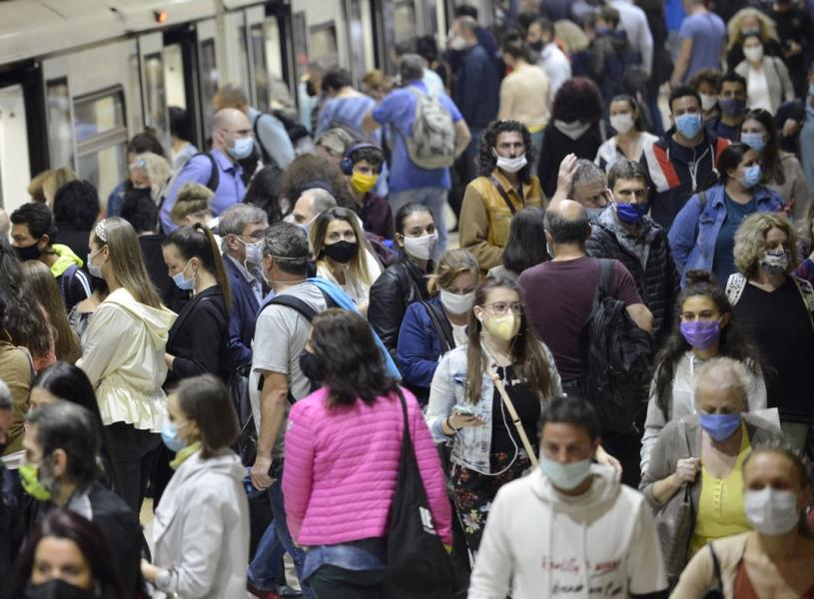
What about COVID-19 Spreading Phenomena?
We can use these two sources to find out our local risks for Datalab for example:
https://www.nationalgeographic.com/science/article/how-to-measure-risk-airborne-coronavirus-your-office-classroom-bus-ride-cvd
https://coronadashboard.rijksoverheid.nl/gemeente/GM0758/positief-geteste-mensen
A statistical or numerical model is always an approximation of the real thing: it is virtually impossible to take all variables of interest into account for a give prediction.
One of the key shortcomings of the model above is that it assumes that nobody: violates social-distancing, is immune yet, or tested negative... So chances are significantly lower for us.

Slide 24
How do we do all this?
We’ll get into that next self-study day, it’s better to consume and apply knowledge in small chunks.
Now let’s look at the course approach and structure!
Then we’ll have some hands-on work: how to use a data analysis tool called Power-BI.
Power-BI is great for describing and visualising data!.

Slide 25
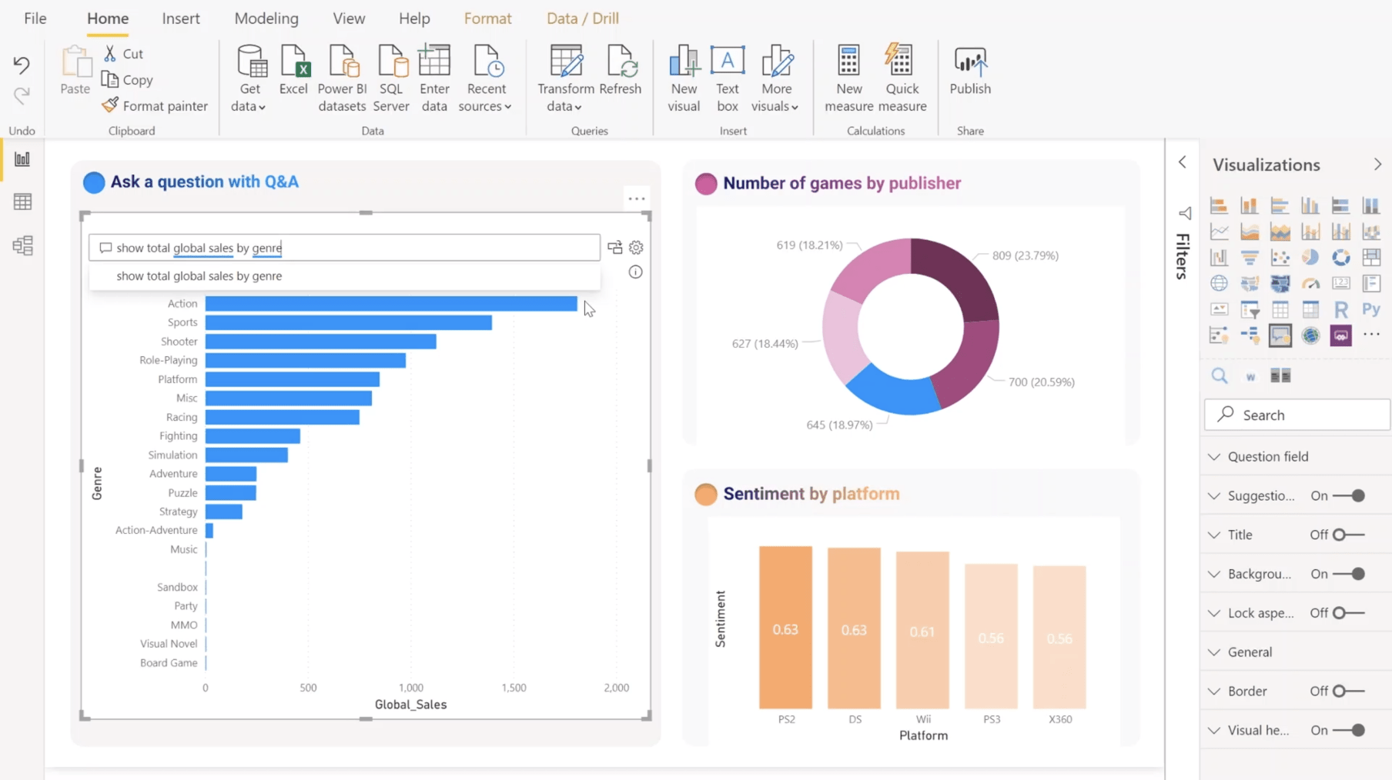
How do we do all this?
Power-BI is great for describing and visualising data!.

Slide 26
Course Approach
Self Study days: Feel free to plan as you like. However, you’ll have the highest likelihood of efficient learning if you do study on the allocated days, specifically: Monday, Tuesday & Thursday: 9:00 – 16:00
Datalab days (Mandatory):
- Wednesday & Fridays from 9:00 to 17:00 in Fe1.036.
Click here for a map of the Buas Campus!

Slide 27

Course Approach
Self Study days: Structured is described at the start of each ADSAI page. Generally, it is as follows:
Intro
Interactive exercises: Datacamp!
Datalab Preparation
Datalab days (Mandatory):
Depends on the project brief but generally you create 1 building block of your dashboard each Datalab day.

Slide 28
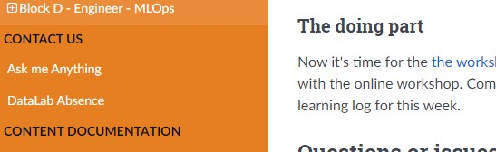
Practical Info
Questions? First ask a peer! They’re often having the same questions and have solved (similar problems!)
Still left wondering? Than address any and all content related questions to me using the AMA form and I’ll respond to them as soon as possible!
If they are not content or Power-BI related questions, ask your mentor!

Slide 29
Assessment
Create a dashboard based on case studies and examples introduced online and in-class; the focus is on all stages of the data science process (save the deploy step):
formulating the problem;
selecting the data;
exploratory data analyses technique(s);
interpretation of descriptive data;
reporting and visualizing the data;
propose next steps: an analysis to run on the data.
Building blocks for the final dashboard are created during each datalab day! You can always discuss them with your mentor! So, it you attend; and work during, all the Datalabs, you should be golden!
Notes:
So there's only one assement: the datalab one.

Slide 30
Any questions?
First ask a peer! They’re often having the same questions and have solved (similar problems!)
Still left wondering? Then adress any and all content related questions to me using the AMA form and I’ll respond to them as soon as possible!
If they are not content or Power-BI related questions, ask your mentor!
Typo or other mistake on Github, please message me on Microsoft Teams and I’ll fix the issue asap!

Slide 31
Time to open the ADSAI site!
And navigate to today’s content if you haven’t done so already!
Otherwise, type in: adsai.buas.nl
Notes:
So there's only one assement: the datalab one.

